Slide 1
Chapter 7
Social Commerce

Slide 2
Learning Objectives
Understand the Web 2.0 revolution, its characteristics and the context of social media.
Describe the fundamentals of social commerce, its drivers and landscape.
Describe the major models of social shopping.
Explain how advertising and promotions are conducted in social networking environments.
Understand how market research is conducted in social networking environments.
Describe how customer service, customer support, and CRM can be facilitated by social networking.
Describe the major social commerce activities that can be conducted within and by enterprises.

Slide 3
Learning Objectives
Define crowdsourcing and describe its use in social commerce.
Describe the commercial applications conducted in virtual worlds in general and in Second Life in particular.
Review the social commerce activities and relationship with e-entertainment and gaming.
Describe and discuss the major implementation issues of social commerce including strategy, security, and ROI.
Understand the major risks, concerns, and barriers of deploying social commerce applications.

Slide 4
The Web 2.0 and Social Media Revolutions
WEB 2.0 AND ITS CHARACTERISTICS
Representative Characteristics of Web 2.0
user-generated content (UGC)
Various kinds of media content that are produced by end users and are publicly available
New Business Models
WELCOME TO THE WEB 2.0 REVOLUTION

Slide 5
The Web 2.0 and Social Media Revolutions
social media
The online platforms and tools that people use to share opinions, experiences, insights, perceptions, and various media, including photos, videos, and music, with each other
social marketing
A combination of social policy and marketing practices to achieve a set of social behavioral goals within a target audience

Slide 6
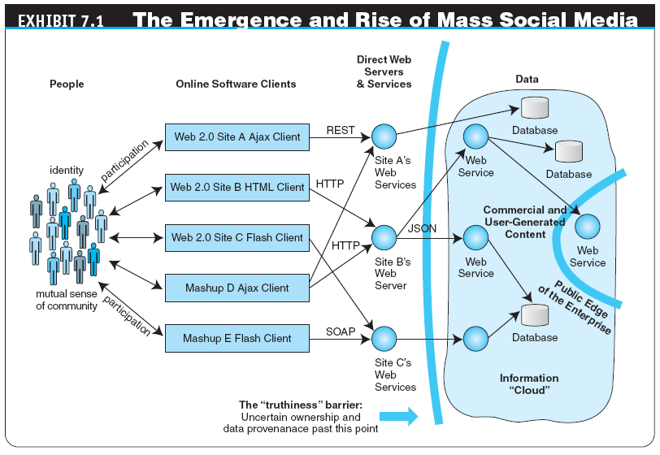

Slide 7
The Web 2.0 and Social Media Revolutions
social capital
A sociological concept that refers to connections within and between social networks—the core idea is that social networks have value; just as physical capital or human capital can increase productivity (both individual and collective), so do social contacts affect the productivity of individuals and groups
social media marketing (SMM)
A term that describes use of social media platforms such as networks, online communities, blogs, wikis, or any other online collaborative media for marketing, market research, sales, CRM, and customer service; it may incorporate ideas and concepts from social capital, Web 2.0, social media, and social marketing

Slide 8
The Web 2.0 and Social Media Revolutions
SOCIAL NETWORKS AND SOCIAL NETWORKING
The Social Networking Space
social graph
A term coined by Mark Zuckerberg of Facebook, which originally referred to the social network of relationships between users of the social networking service provided by Facebook—the idea was for Facebook to benefit from the social graph by taking advantage of the relationships between individuals that Facebook provides, to offer a richer online experience—this definition was expanded to refer to a social graph of all Internet users

Slide 9
The Fundamentals of Social Commerce and Social Networking
social commerce (SC)
The delivery of e-commerce activities and transactions through social networks and/or via Web 2.0 software

Slide 10
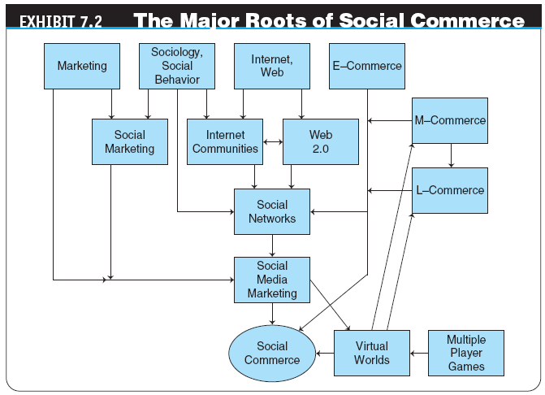

Slide 11
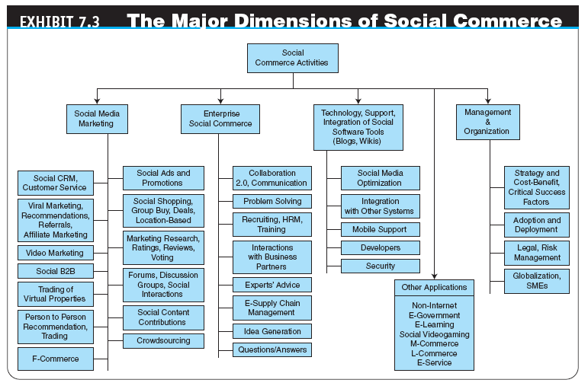

Slide 12
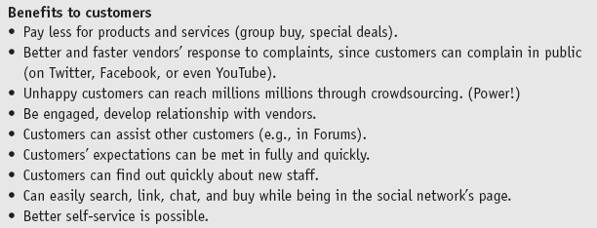
The Fundamentals of Social Commerce And Social Networking
THE POTENTIAL BENEFITS OF SOCIAL COMMERCE

Slide 13
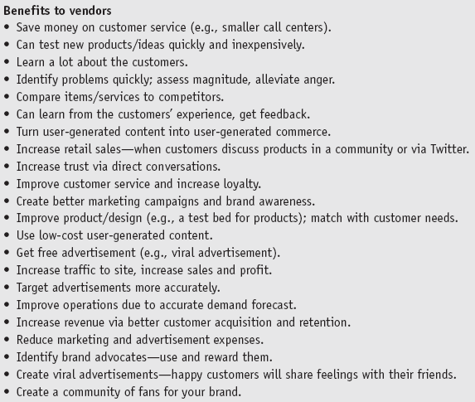

Slide 14
The Fundamentals of Social Commerce And Social Networking
Benefits to Retailers
Consumers can provide feedback
Word-of-mouth marketing (i.e., viral marketing) is free advertising
Increased website traffic brings more revenue dollars with it
Increased sales can come from harnessing techniques based on personal preferences such as collaborative filtering and targeted advertisement
Over 40 percent of businesses globally found new customers via social networks
Over 27 percent of companies invest in social networking in order to acquire and retain customers
New or Improved Business Models

Slide 15
The Fundamentals of Social Commerce And Social Networking
mobile social networking
Members converse and connect with one another using cell phones or other mobile devices
CONCERNS AND LIMITATIONS OF CONDUCTING SOCIAL COMMERCE

Slide 16
Social Shopping: Concepts, Benefits, and Models
social shopping
A method of e-commerce where shoppers’ friends become involved in the shopping experience; social shopping attempts to use technology to mimic the social interactions found in physical malls and stores
Concepts and Content of Social Shopping
Why Shoppers Go Social
communal shopping
A method of shopping where the shoppers enlist others to participate in the purchase decision

Slide 17
Social Shopping: Concepts, Benefits, and Models
The Roles in Social Commerce
Connector
Salesman
Seeker
Maven
Self-sufficient
Unclassified
Benefits of Social Shopping

Slide 18
Social Shopping: Concepts, Benefits, and Models
THE MAJOR MODELS OF SOCIAL SHOPPING
Social recommendations, ratings and reviews, comparisons, and conversations
Group buying and shopping together
Deal purchases (flash sales), such as daily deals
Shopping communities and clubs
Peer-to-peer models (e.g., money lending)
Location-based shopping
F-commerce; shopping at Facebook
Shopping with Twitter
Other innovative models

Slide 19
Social Shopping: Concepts, Benefits, and Models
RATINGS AND REVIEWS, SOCIAL RECOMMENDATIONS, ADVICE, COMPARISONS, AND CONVERSATIONS
Ratings and Reviews
Customer ratings and reviews
Expert ratings and reviews
Sponsored reviews
Conversational marketing
Video product review
Customer testimonials

Slide 20
Social Shopping: Concepts, Benefits, and Models
Social Recommendations and Referrals
Share with your network (social bookmarking)
Referral programs
Social recommendations
Innovative methods
GROUP BUYING, DEAL PURCHASING, AND SHOPPING TOGETHER
Deal Purchases (Flash Sales)
Group Buying in China
Real-Time Online Shopping Together

Slide 21
Social Shopping: Concepts, Benefits, and Models
SHOPPING COMMUNITIES AND CLUBS
Private Online Shopping Clubs and Retail by Invitation
Kaboodle, a Unique Social Community
OTHER INNOVATIVE MODELS
social marketplace
An online community that harnesses the power of one’s social networks for the introduction, buying, and selling of products, services, and resources, including one’s own creations; also may refer to a structure that resembles a social network but is focused on individual members
Direct Sales from Social Networks

Slide 22
Social Shopping: Concepts, Benefits, and Models
WHAT COMPONENTS TO EXPECT IN A SOCIAL SHOPPING SITE
B2B Social Networking
Socially-Oriented Person to Person (P2P) Selling, Buying, Renting, or Bartering
Social Shopping in the Near Future

Slide 23
Social Advertising
SOCIAL ADS AND SOCIAL APPS
viral marketing
Word-of-mouth (WOM) method by which customers promote a product (service) by telling others (frequently their friends) about it
viral blogging
Viral (word-of-mouth) marketing done by bloggers

Slide 24
Social Advertising
LOCATION-BASED ADVERTISEMENT AND SOCIAL NETWORKS
geosocial networking
A type of social networking in which geographic services and capabilities such as geocoding and geotagging are used to enable additional social dynamics
geolocation
The identification of the real-world geographic location of an Internet-connected computer, mobile device, website visitor, or other

Slide 25
Social Advertising
The Technology for Location-Based Social Networks
From Foursquare to Facebook Places
Strategy for Small Businesses
Privacy Concerns
Examples of Successful Location-Based Applications

Slide 26
Social Advertising
USING YOUTUBE AND OTHER SOCIAL PRESENTATION SITES FOR ADVERTISING
viral video
Any video that is passed electronically, from person to person, regardless of its content
USING TWITTER AS AN ADVERTISING AND MARKETING TOOL

Slide 27
Social Advertising
OTHER INNOVATIVE WAYS TO ADVERTISE IN SOCIAL MEDIA
The Changing Rules of Branding
Using Blogs
Special Advertising Campaigns
Mobile Advertising

Slide 28
Market Research and Strategy in Social Networks
USING SOCIAL NETWORKING FOR MARKET RESEARCH
FEEDBACK FROM CUSTOMERS: CONVERSATIONAL MARKETING
Illustrative Examples
SOCIAL ANALYTICS AND SOCIAL INTELLIGENCE IN SOCIAL COMMERCE

Slide 29
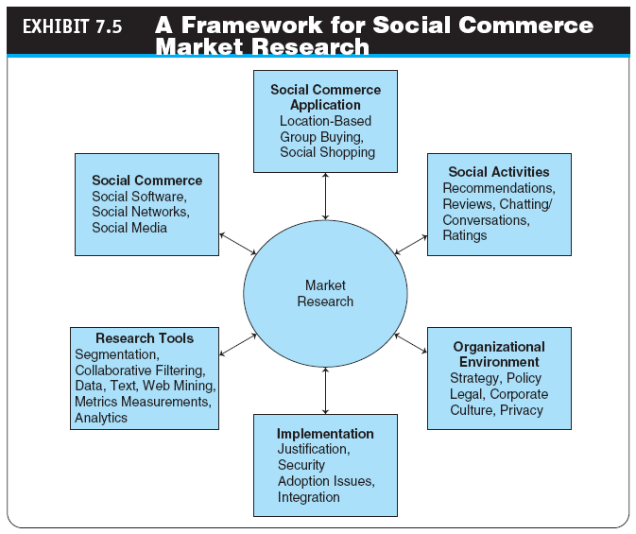

Slide 30
Market Research and Strategy in Social Networks
SOCIAL ANALYTICS FOR SOCIAL INTELLIGENCE IN SOCIAL COMMERCE
Social Intelligence and Its Components
ANALYZING CONSUMER CONVERSATIONS AND OTHER USER GENERATED CONTENT
Tools for Mining Social Media for Consumer Trends

Slide 31
Market Research and Strategy in Social Networks
CONDUCTING MARKET RESEARCH USING THE MAJOR SOCIAL NETWORKS
Using Facebook for Market Research
Using Twitter for Market Research
Using LinkedIn for Market Research
PUTTING IT ALL TOGETHER

Slide 32
Social Customer Service and CRM
HOW SOCIAL NETWORKING IMPROVES CUSTOMER SERVICE
Methods and Guidelines for Service
HOW TO SERVE THE SOCIAL CUSTOMERS
social customers
Members of social networks who do social shopping and understand their rights and how to use the wisdom and power of crowdsourcing and communities to their benefit
customer relationship management (CRM)
A customer service approach that focuses on building long-term and sustainable customer relationships that add value both to the customers and the merchants

Slide 33
Social Customer Service and CRM
social CRM (SCRM)
A customer engagement strategy in support of companies’ defined goals and objectives toward optimizing the customer experience: success requires a focus on people, processes, and technology associated with customer touchpoints and interactions
Social CRM in the Enterprise and B2B Environments

Slide 34
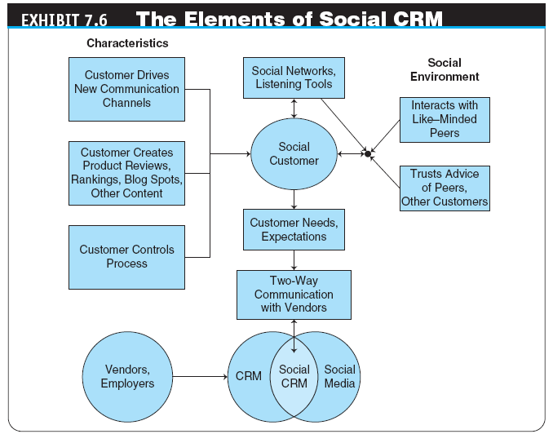

Slide 35
Social Customer Service and CRM
IMPLEMENTATION OF SOCIAL CUSTOMER SERVICE AND CRM
How Social CRM Works—Problems and Solutions
SOME MORE ADVANCED APPLICATIONS
Social Networking Helps Customer Service in Small Companies

Slide 36
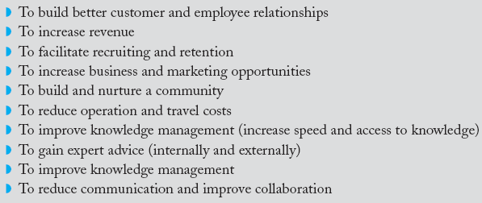
Enterprise Applications
business social network
A social network whose primary objective is to facilitate business connections and activities
THE BENEFITS OF ENTERPRISE BUSINESS SOCIAL NETWORKING

Slide 37
Enterprise Applications
Business-Oriented Public Social Networking
Entrepreneur Networks
Ryze
The Business Social Network
Yammer
Viadeo
APSense
Biznik
E. Factor
Startup Nation
Entrepreneur Co

Slide 38
Enterprise Applications
ENTERPRISE PRIVATE SOCIAL NETWORKS
Taxonomy of Social Enterprise Applications
Characteristics of Enterprise Social Networks
Guidelines for Effective Social Networking
An Example of Enterprise Networks
How Enterprise Social Networking Helps Employees
Support Services for Enterprise Social Networks

Slide 39
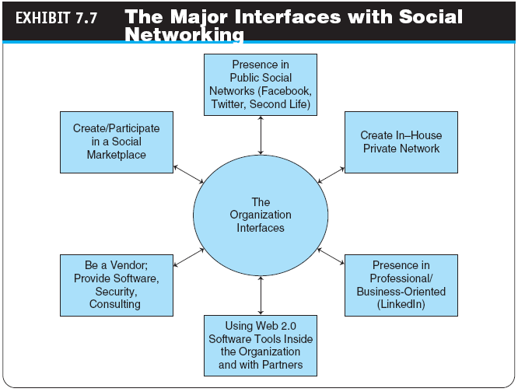

Slide 40
Enterprise Applications
HOW COMPANIES INTERFACE WITH SOCIAL NETWORKS AND NETWORKING
COMMERCIAL ACTIVITIES IN ENTERPRISE SOCIAL NETWORKS
SOCIAL HUMAN RESOURCE MANAGEMENT
Finding, Recruiting, and Training Workers

Slide 41
Enterprise Applications
MANAGERIAL PROBLEM SOLVING, INNOVATIONS, AND KNOWLEDGE MANAGEMENT
Idea Generation and Problem Solving
Problem-Solving Sites
Social Networking and Organizational Knowledge
USING WEB 2.0 TOOLS FOR MANAGERIAL TASKS
Using Blogs and Wikis Inside the Enterprise
Questions and Answers in Social Networks
A Suite of Tools for Social Collaboration

Slide 42
Crowdsourcing
crowdsourcing
The act of outsourcing tasks, traditionally performed by an employee or contractor, to an undefined, large group of people or community (a “crowd”), through an open call
Crowdsourcing Models
Benefits of Crowdsourcing

Slide 43
Crowdsourcing
THE PROCESS OF CROWDSOURCING
Identify the issue (problem) you want to investigate or solve
Identify the target crowd
Broadcast to the unknown crowd
Engage the crowd in an innovative and creative process
User-generated content is submitted
Evaluate the submitted material

Slide 44
Crowdsourcing
collective intelligence (CI)
The capacity of human communities to evolve toward higher order complexity and harmony, through such innovation mechanisms as variation-feedback-selection, differentiation-integration-transformation, and competition-cooperation-coopetition
SUCCESSFULLY DEPLOYED CROWDSOURCING SYSTEMS
ISSUES AND CONCERNS IN IMPLEMENTING CROWDSOURCING
TOOLS FOR CROWDSOURCING
Hypios: A Marketplace for Crowdsourcing

Slide 45
Social Commerce: Applications in Virtual Worlds
THE FEATURES AND SPACES OF VIRTUAL WORLDS
The Features That Businesses Can Leverage
THE LANDSCAPE OF VIRTUAL WORLD COMMERCIAL APPLICATIONS
The Seven Dimensions of Virtual Worlds
Social space
Entertainment space
Transaction space
Experimental/demonstration space
Collaboration space
Smart agents space
Fantasy space

Slide 46
Social Commerce: Applications in Virtual Worlds
The Major Categories of Virtual World Applications
Storefronts and online sales
Front offices or help desks
Advertising and product demonstrations
Content creation and distribution
Meetings, seminars, and conferences
Training
Education
Recruiting
Tourism promotion
Museums and art galleries
Information points
Data visualization and manipulation
Renting virtual world land and buildings
Platform for social science research
Market research
Platform for design
Providing CRM to employees
Commercial gaming
Virtual trade shows

Slide 47
Social Commerce: Applications in Virtual Worlds
Applications in Virtual Worlds
Additional Virtual World Applications Around the Globe
Trading Virtual Goods and Properties
THE MAJOR DRIVERS OF SOCIAL COMMERCE IN VIRTUAL WORLDS
CONCERNS AND LIMITATIONS OF COMMERCIAL ACTIVITIES IN VIRTUAL WORLDS

Slide 48
Entertainment, Multimedia Sharing, and Social Games
ENTERTAINMENT AND SOCIAL NETWORKS
Mixi
Last.fm
Pandora
Internet Series and Movie Streaming
MOBILE WEB 2.0 DEVICES FOR ENTERTAINMENT AND WORK
iPhone and Its Clones
MULTIMEDIA PRESENTATION AND SHARING SITES

Slide 49
Entertainment, Multimedia Sharing, and Social Games
social game
A video game played in a social network
Games on Social Networks
Conclusions: The Business Aspects

Slide 50
Justification, Risks, Other Implementation Issues, and Strategy
THE COMPLEXITY OF SOCIAL COMMERCE IMPLEMENTATION
JUSTIFICATION, COST–BENEFIT, AND ROI OF SOCIAL COMMERCE SYSTEMS
Measuring Social Commerce ROI
Using Metrics
RISK FACTORS AND ANALYSIS
Risk to Users
OTHER IMPLEMENTATION ISSUES
Support Services

Slide 51
Justification, Risks, Other Implementation Issues, and Strategy
REPUTATION SYSTEM MANAGEMENT
A STRATEGY FOR SC SUCCESS OF IMPLEMENTATION
Learn and understand the environment inside and outside the organization
Experiment with a small-scale project so you can observe and learn
Assess the results of the experiment
Develop or abandon the project

Slide 52
Justification, Risks, Other Implementation Issues, and Strategy
Examples
Success in SMEs
Some Other Strategy Issues
Some Policies and Guidelines
Internet Use and Social Commerce Policies
Adoption Strategies

Slide 53
Justification, Risks, Other Implementation Issues, and Strategy
REVENUE-GENERATION STRATEGIES IN SOCIAL NETWORKS
Increased Revenue and Its Benefits
THE FUTURE OF SOCIAL COMMERCE
Conclusion: IBM’s Watson and Social Commerce

Slide 54
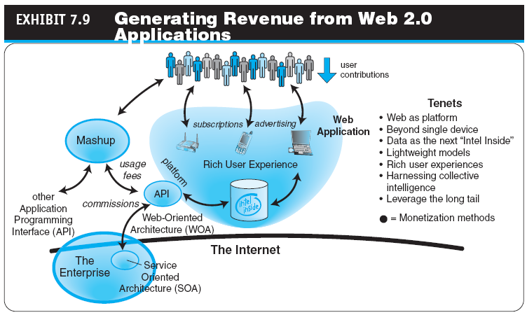

Slide 55
Managerial Issues
How will social commerce impact businesses?
Should we explore Web 2.0 collaboration?
How to deal with ethical and etiquette issues?
What are the ethical issues that may be involved in deploying social commerce?
Do we need to sponsor a social network?
How should we deal with social commerce risks?
Should we have an in-house social network? How do we get the employees to use it?
Is it wise for a small business to be on Facebook?
What shall I do now?

Slide 56
Summary
The Web 2.0 revolution and social media
Fundamentals, drivers, and the landscape of social commerce
Major models of social shopping
How advertisement and promotions are conducted in social networking
Conducting market research

Slide 57
Summary
Conducting customer service and CRM
Major enterprise social commerce activities
Crowdsourcing and social networking
Commercial application of virtual worlds
Social commerce, entertainment, and gaming
Implementing social commerce
Risks and concerns in deploying social commerce

Slide 58
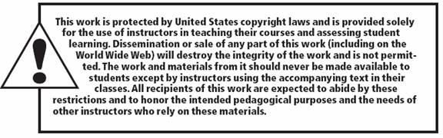
All rights reserved. No part of this publication may be reproduced, stored in a retrieval system, or transmitted, in any form or by any means, electronic, mechanical, photocopying, recording, or otherwise, without the prior written permission of the publisher. Printed in the United States of America.
Copyright © 2012 Pearson Education, Inc.
Publishing as Prentice Hall

